Slide 1


Revolutionizing Urban Mobility: The Benefits and Challenges of Implementing Smart Parking Solutions

Slide 2

Introduction
Revolutionizing Urban Mobility: The Beneﬁts and Challenges of Implementing Smart Parking Solutions.
Urban mobility is a major challenge in today's cities. Smart parking solutions can help reduce congestion, pollution, and improve the quality of life for residents. In this presentation, we will explore the beneﬁts and challenges of implementing smart parking solutions.

Slide 3


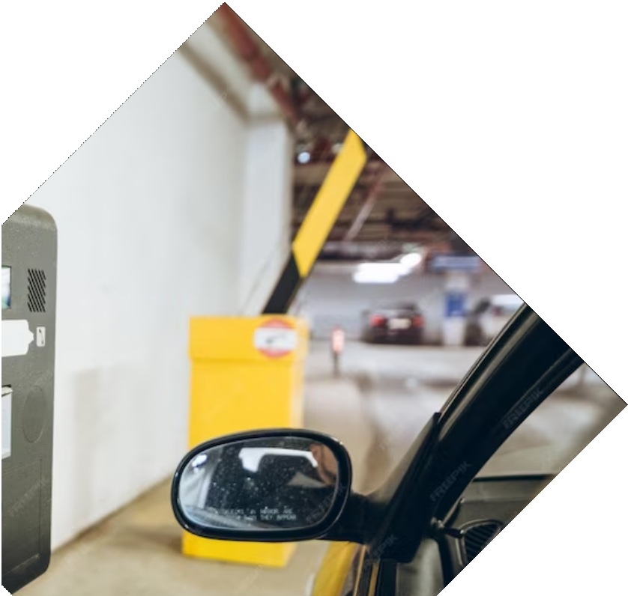
What is Smart Parking?
Smart Parking is a technology-based solution that uses sensors, cameras, and data analytics to optimize parking availability and reduce trafﬁc congestion. By providing real-time information on parking availability, drivers can save time and reduce emissions by avoiding unnecessary driving. Smart parking also enables cities to better manage parking resources and generate revenue.

Slide 4
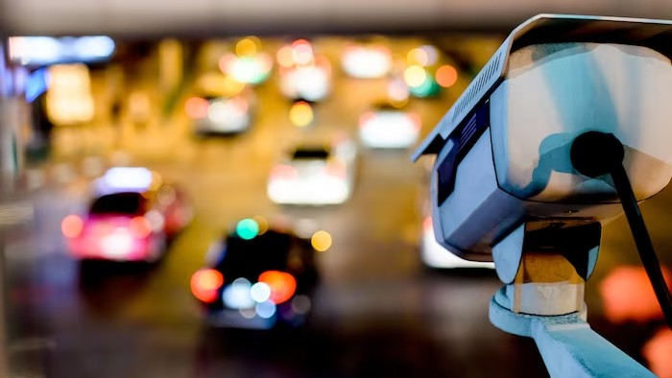

Benefits of Smart Parking
The beneﬁts of Smart Parking include: Reduced trafﬁc congestion Improved air quality Increased revenue for cities Enhanced user experience
Optimized use of parking spaces Reduced parking violations

Slide 5



Challenges of Implementing Smart Parking
The challenges of implementing Smart
Parking include: High initial costs
Technical complexity Privacy concerns Resistance to change Maintenance requirements
Integration with existing systems

Slide 6

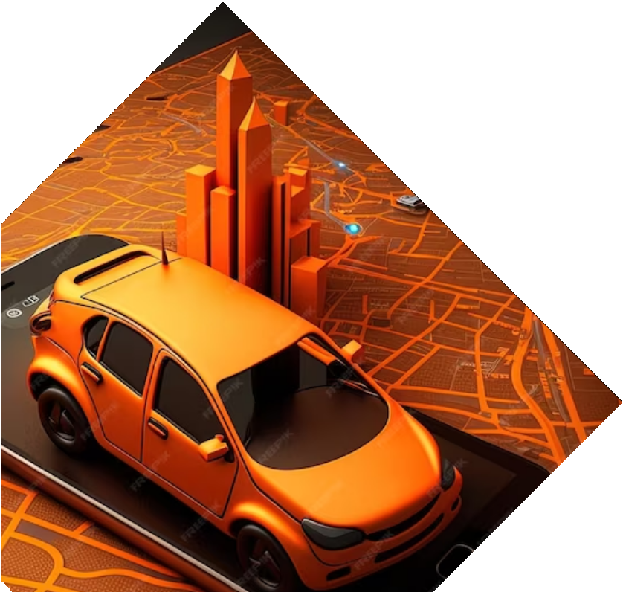
Successful Smart Parking Implementations
Several cities have successfully implemented Smart Parking solutions, including:
San Francisco
Barcelona Singapore Los Angeles Copenhagen Amsterdam

Slide 7

Conclusion
In conclusion, Smart Parking solutions have the potential to revolutionize urban mobility by reducing trafﬁc congestion, improving air quality, and enhancing the user experience. While there are challenges to implementation, several cities have successfully implemented smart parking solutions. With careful planning and execution, smart parking can help create more livable and sustainable cities.

